Slide 1
Programming JAVA {
Hiveed.java
Methods
/* Here is where your journey for your dream begins */
}
JAVA Programming

Slide 2
Hiveed.java
METHODS :
A block of instruction thart can be executed .When the programmer call the method .
There are two Types are method
Pre-defined method.
user-defined method.
JAVA Programming

Slide 3
Hiveed.java
Methods
Static Method
non-Static Method
JAVA Programming

Slide 4
Hiveed.java
Method Syntax :
[access modifier] [static] [return type] [method name] ([parameter]) {
// Method body
}
Rules :
The words Which is red color are optional . While others are optional.
Access modifiers are specify the accessablity of the method. Which will be discusses in upcomming class.
JAVA Programming

Slide 5
Hiveed.java
Method Syntax :
[access modifier] [static] [return type] [method name] ([parameter]) {
// Method body
}
Rules :
static-modifers is a keyword is indicates wheather the method is is belong to the class itself ( or ) related to memory creation. static , abstract , final , synchronized , native etc....
Return Type Which Specify the data type that will return by method after perform the operation.
JAVA Programming

Slide 6
Hiveed.java
Method Syntax :
[access modifier] [static] [return type] [method name] ([parameter]) {
// Method body
}
Rules :
method name : unique identifier of the method.
Parameter specify the data type and number of parameter pass to the method.
JAVA Programming

Slide 7
Hiveed.java
STATIC METHOD :
Method which is prefixed static keyword is called static method.
Static methods cannot access or change the values of instance variables , but they can access or change the values of static variables.
HOW TO ACCESS THE STATIC METHOD :
By using direct method name.
By using ClassName followed by methodName
By using Object reference variable.
JAVA Programming

Slide 8
Hiveed.java
Arguments :
methodName( [ data ] )
Actual Arguments ( donate the data)
ClassName.methodName( [ data ] )
//method Call Statement
Formal Arguments ( Accept Aruguments)
JAVA Programming

Slide 9
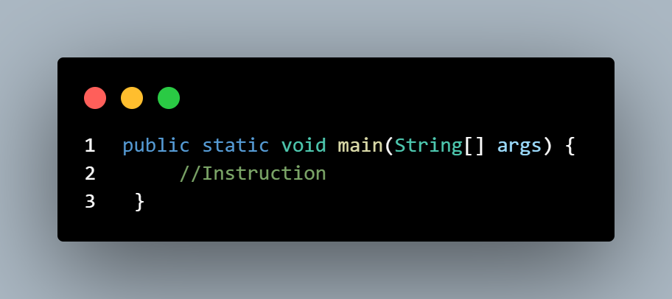
Hiveed.java
Main Method / static method:
Access
Modifier
Method Name
String aruguments
modifier
Return
type
JAVA Programming

Slide 10
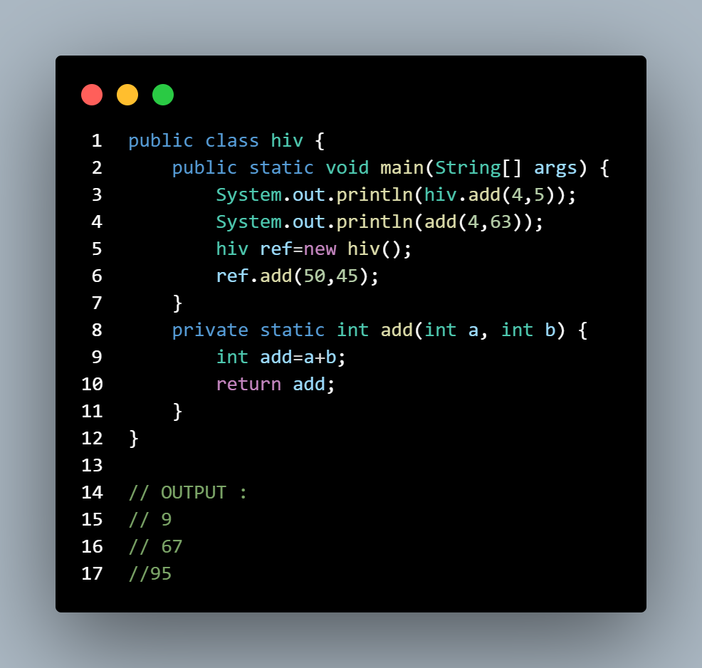
Hiveed.java
Static Method Calling Statement using ClassName.Method Name.
Directly by using method name
By Using Object reference
Return DataType
Return Statement.
JAVA Programming

Slide 11
Hiveed.java
non-static Method :
A method Which is not prefixed with the static modifier is called the non-static method.
How to call nonstatic Method :
By using Object reference
JAVA Programming

Slide 12
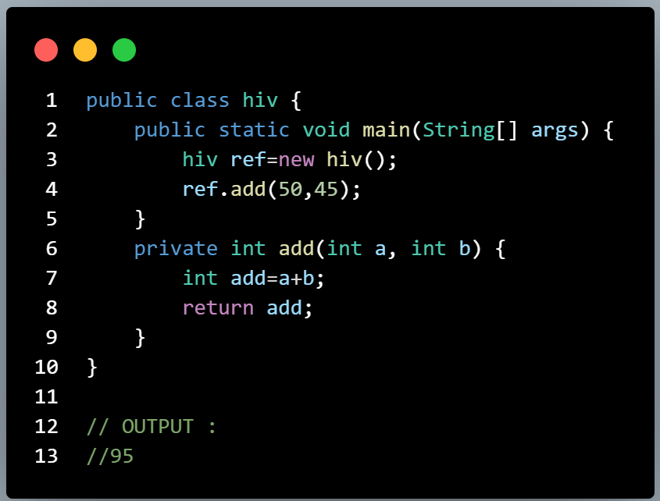
Hiveed.java
Call By Object
JAVA Programming

